Slide 1

Computer Science & Engineering ( Data Science )
Presentation on
Grocery Webpage Based on HTML, CSS & JS
Supervisor Name :
Mr. Suraj Bhatnagar
Mr. Rohit Aggarwal
Mr. Babu Kumar
Team Members :
Sandeep Kumar (2000681540035)
Dhairya Rajput (2000681540014)

Slide 2
Table of Contents
Introduction
Modules
Purpose & Scope
Proposed System
Methodology
Use Case Diagram
Tools & Technologies
Screen-Shots : Home, Registration, Login, Product Categories, About Us, Review, Contact, View Cart Page
Bibliography

Slide 3
Introduction
Online Grocery Shopping is the norm these days. In fast pace of time today, everyone is squeezed for time, people want easy shopping without going to shop. The grocery webpage provides many facilities like home delivery at any time, debit card/credit card/net banking/cash on delivery payments systems, add cart or remove etc. Purpose of Online Grocery Shopping system is to allow customer to shop virtually using internet. Computerization of online store will increase the ease, efficiency and reduce the chances of manual errors.
Customers will be able to browse and search products under different categories. Selected products or items selected for purchase would be added into the virtual shopping cart which can be managed separately by customer. It can be examined at any time by customer for selected products, their quantity & price. These would be main functionalities apart from some usual operations such as login, logout, create new account etc.

Slide 4
Modules
This module is meant for customers, where a user will view these panels. The major operations included in this module are :
Home
Shop
About
Review
Contact
View Products
Customer Cart
Login Form

Slide 5
Purpose & Scope
PURPOSE :
To manage the online grocery product ordering.
It helps the customers to buy daily essential products from anywhere without going to the market.
The main purpose is to save time of the people as the service is available 24X7.
SCOPE :
The project has a wide scope, since at this time only the basic functionality is provided.
This project is going to develop personalized recommendations, discount & offer management.
For customers, Notification & messaging etc. can be applied.

Slide 6
Proposed System
The proposed system will ensures the complete freedom for users, where user at his own system can login to the website and can book his products.
Our proposed system will allows only registered users to book the product, view booking and cancel their booking as per their need.
In this proposal, the entire process requires an internet connection.
Here customers can send their queries and suggestions through a feedback form.

Slide 7
Methodology
Planning for project development :
Research : Explore about the different types & qualities of grocery items like fruits, vegetables, oils, meat etc.
Algorithm : Making algorithm for every page
Prototype : Drafted a rough format of web project on papers and then implemented same using HTML, CSS, JS.
Images : Selected set of suitable photos from internet and the resize them and remove background according to the requirements.
Design : Selecting better picture for creative view of the webpage.

Slide 8
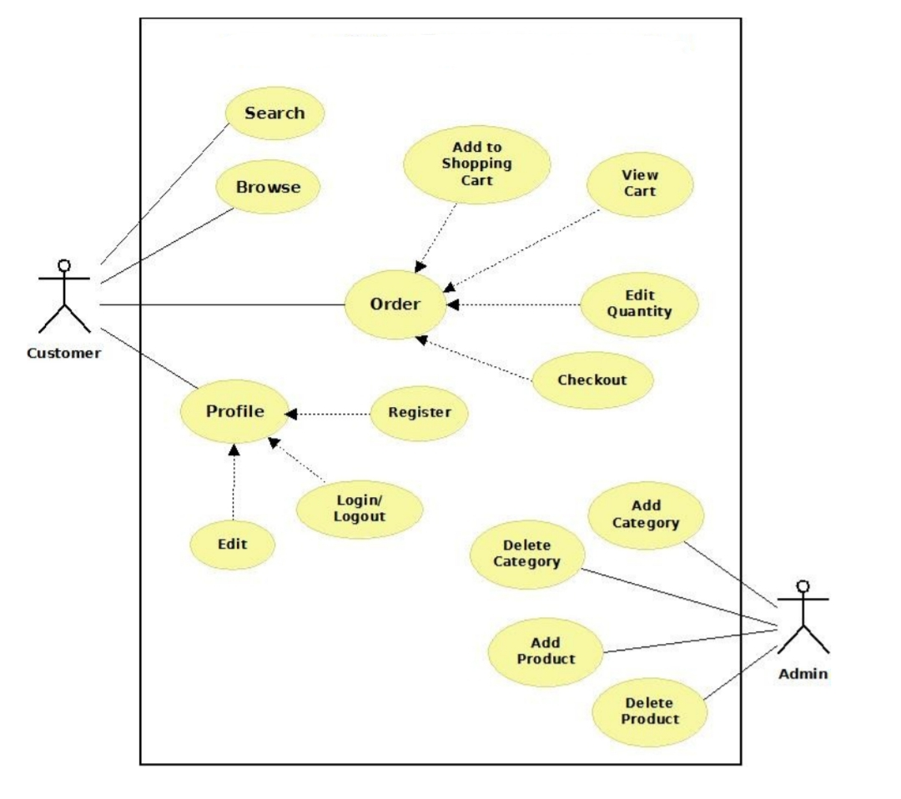
Use Case Diagram

Slide 9
Tools & Technologies
Software
HTML
CSS
Java Script
Web Browser
Window 7 or higher
Hardware
2GB RAM or higher
Active Internet Connection

Slide 10
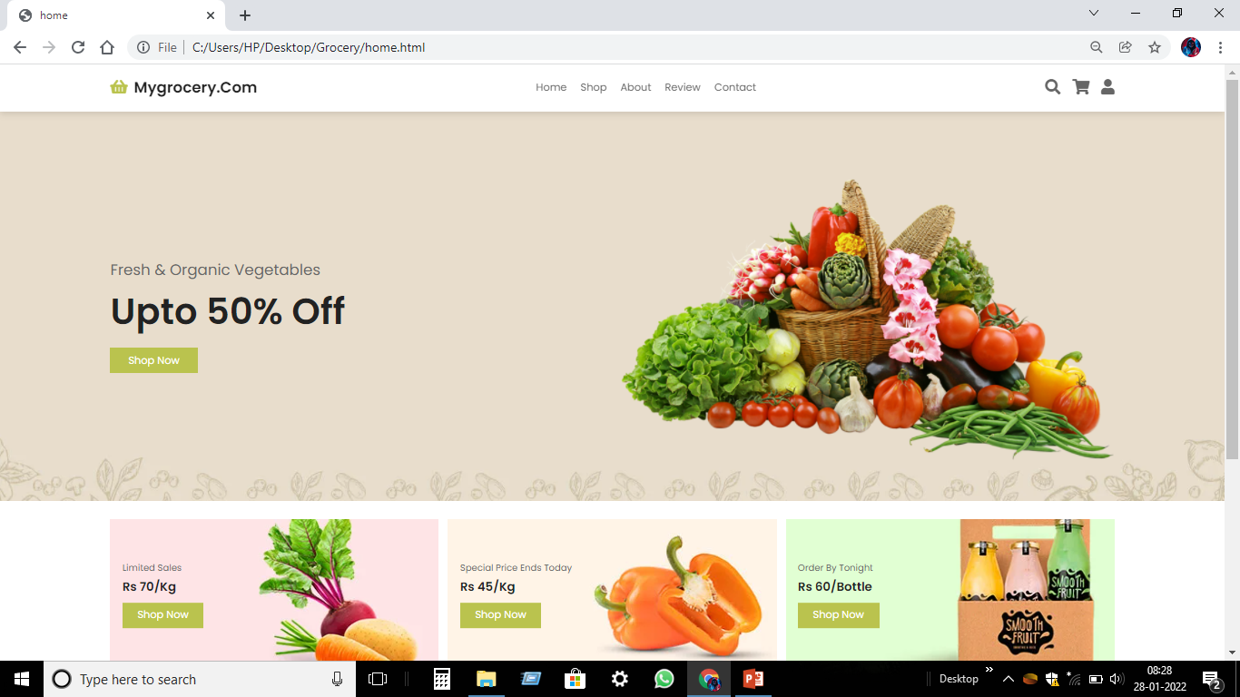
SCREEN-SHOTS : Home Page

Slide 11
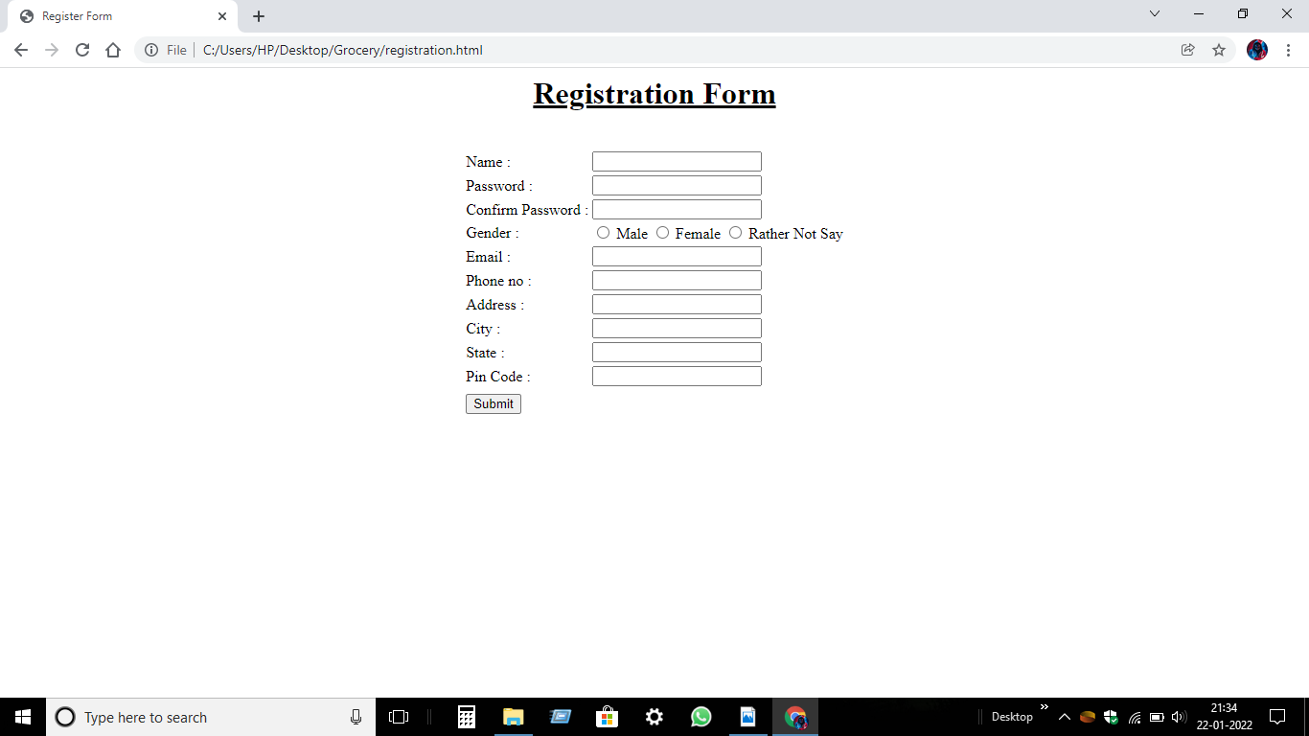
Registration Page

Slide 12
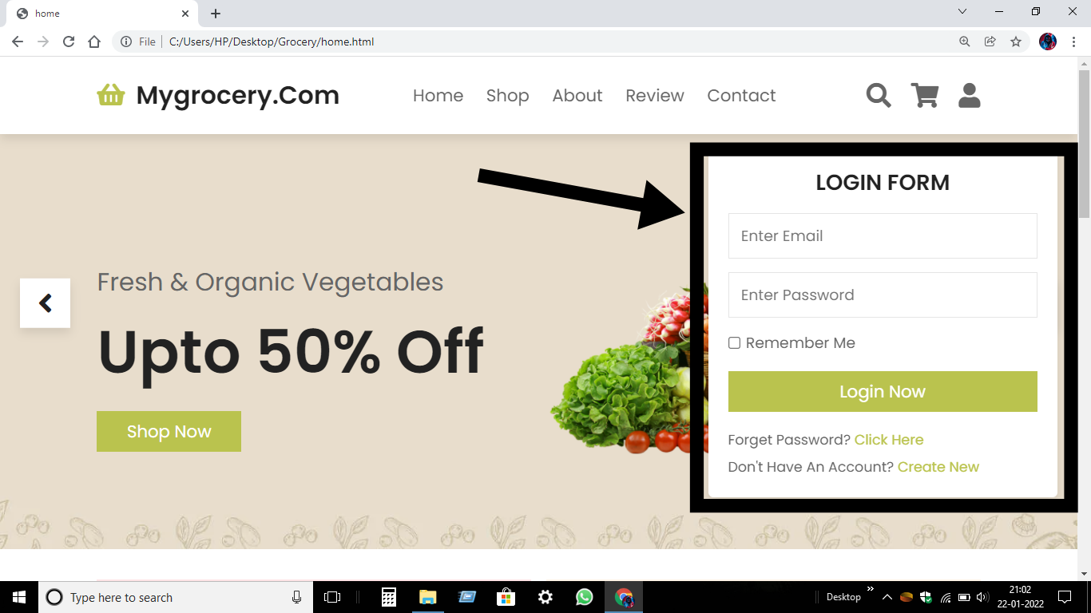
Login Form

Slide 13
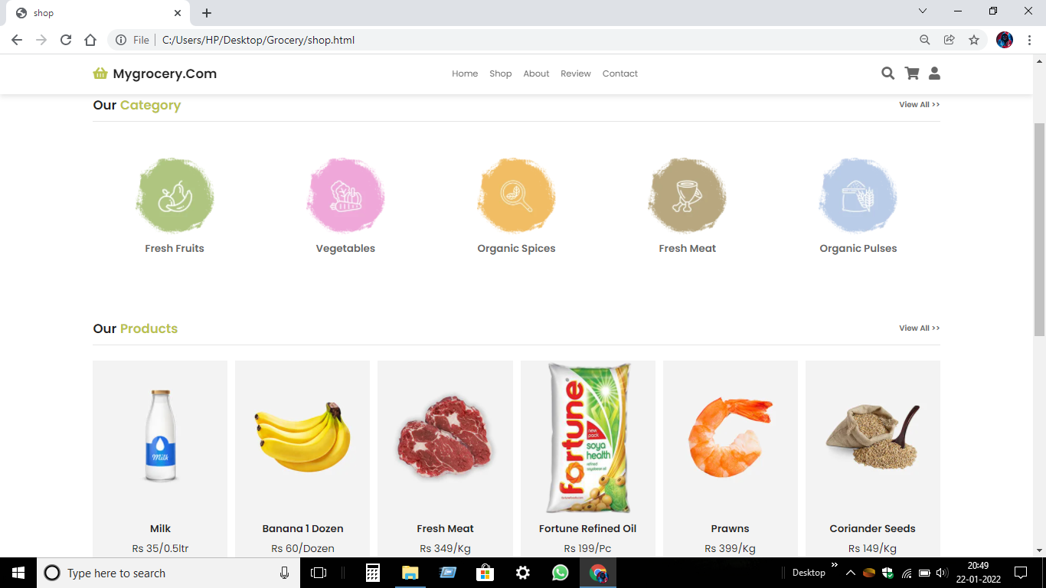
Product Categories Page

Slide 14
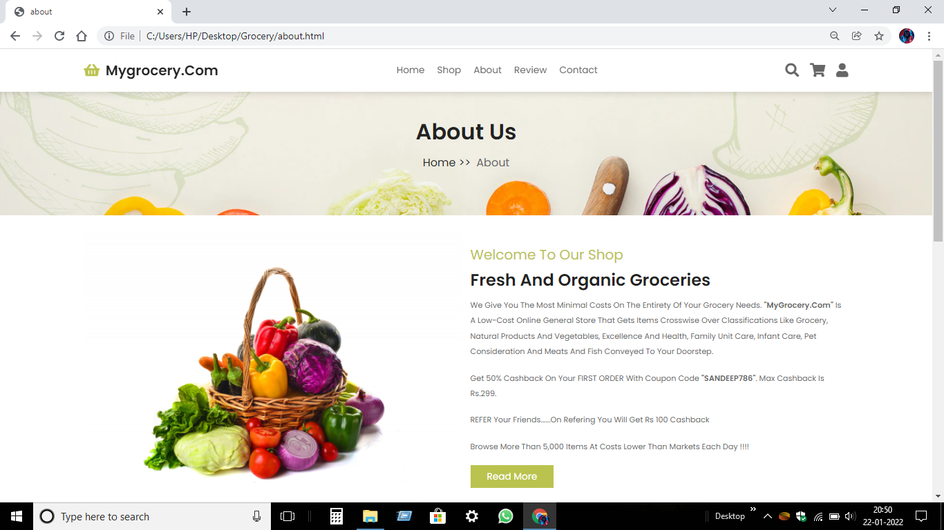
About Us Page

Slide 15
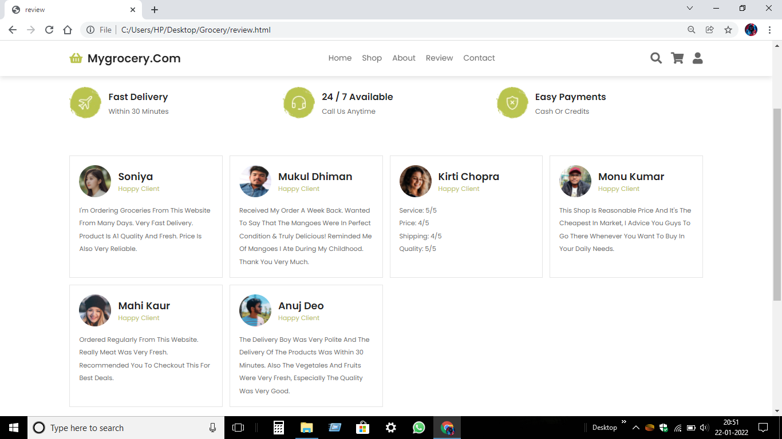
Review Page

Slide 16
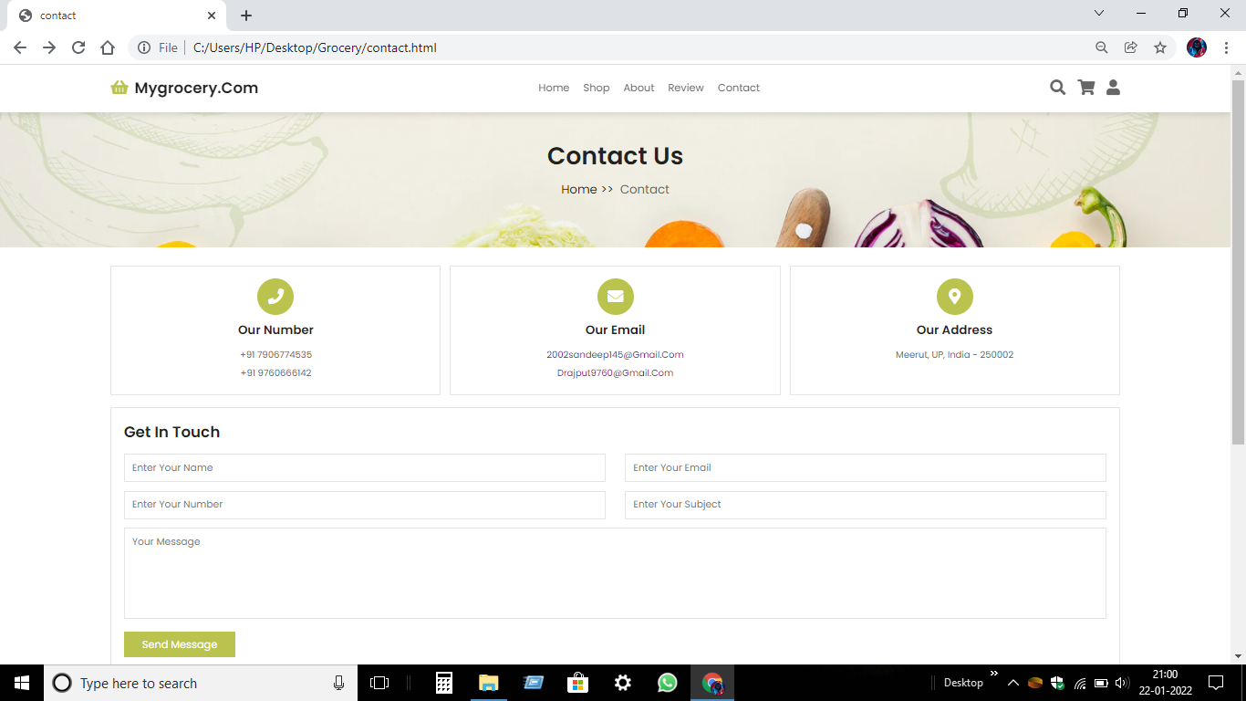
Contact Page

Slide 17
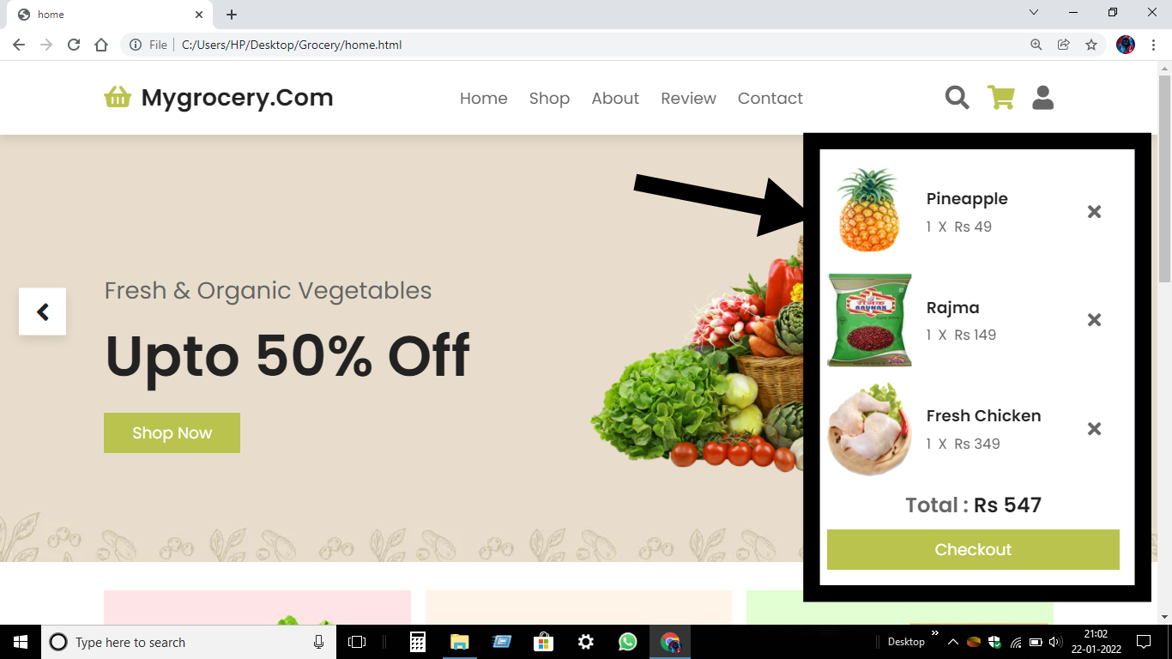
View Cart Page

Slide 18
Bibliography
https://w3schools.com
https://tutorialspoint.com
https://www.resizepixel.com
https://remove.bg

Slide 19
THANK YOU

